Slide 1
A Keyboard For Me
A CISC 4900 Project by Richard Park
Trello: https://trello.com/w/cisc4900vc1brichardpark/home
Github: https://github.com/rsjpark/A_Keyboard_For_Me

Slide 2
Case Design
Original Plans
I had wanted to do a simple no frills case, that would be simple to print/manufacture and wouldn’t take up a bulk of my time.
Demo 1 Timeline
Many of my hours were spent trying to get measurements for all of the aspects of the case, especially ones that I had not originally thought about.
At the moment I have 4 case designs that I’m slightly iterating on, with 2 of them being one that I feel will make the final cut.
I am still figuring out final decisions, as I hadn’t thought of specifics like, where the mounting holes should be since this case won’t be a single rectangle.
I am hoping for a minimal amount of mounting holes so I will continue to iterate

Slide 3
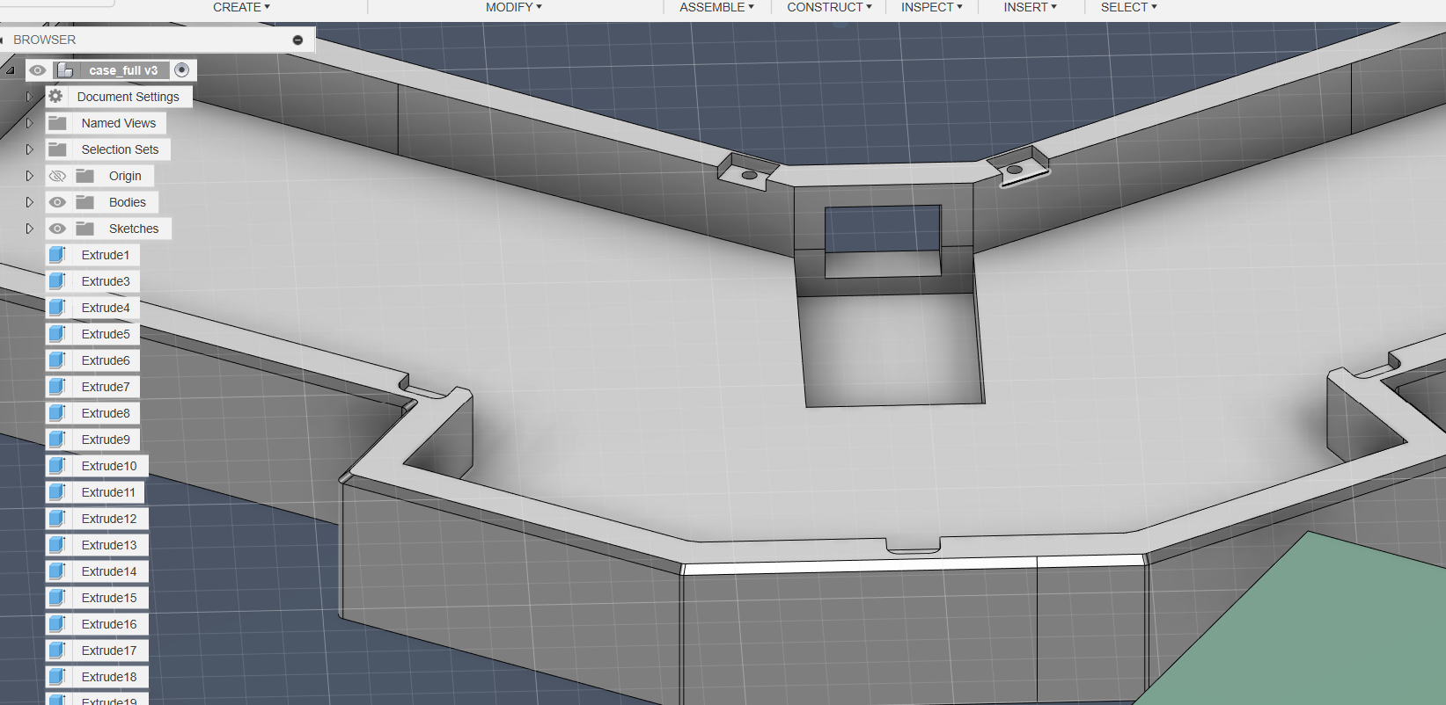
Case Design (cont.)
After Demo 1 Timeline
After all of those designs, I had to scrap them due to pcb issues
Having to accommodate the development board rather than just the mcu meant that I would have to change up dimensions
There would need to be a thicker bottom for a taller cutout, and since the dev board takes quite a bit of space, I needed to make the gap between halves larger

Slide 4
Case Design (cont.)
After Demo 1 Timeline
I decided to wait until my pcb was finalized and until I could get all of the dimensions (pcb, plate, development board, pin headers)
This step took quite a while

Slide 5
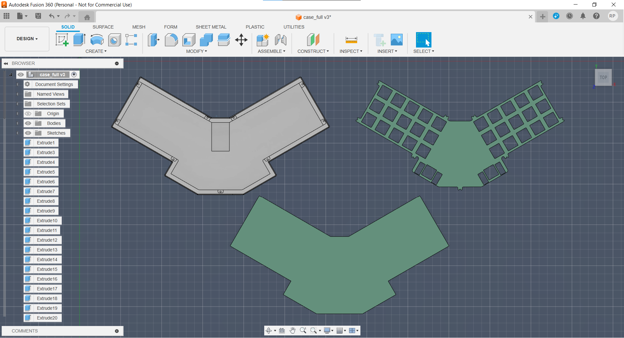
Case Design (cont.)
After Demo 1 Timeline
The dimensions were given by creating an object in kicad that traced the dimensions of the plate and then imported as a step file into fusion
After some hard fought tinkering the case came into its own

Slide 6
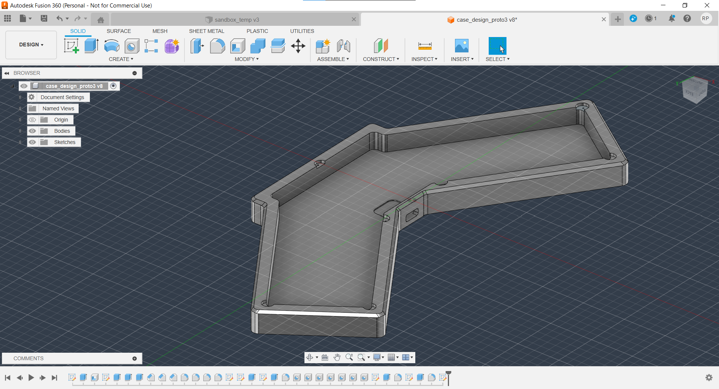
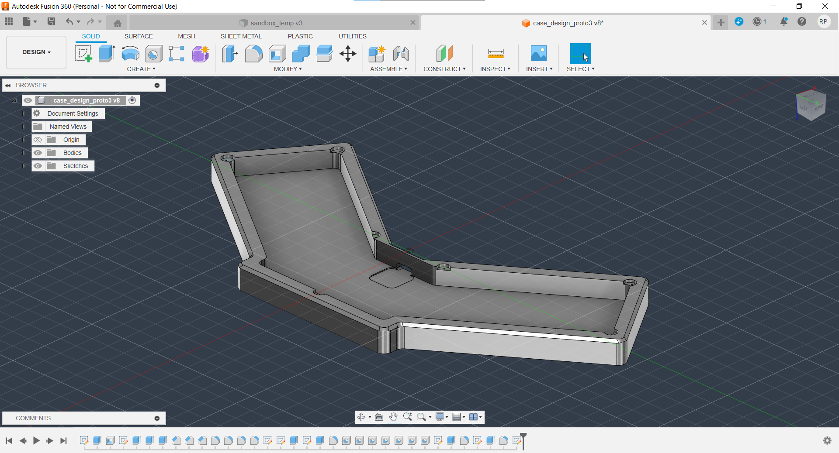
Case Manufacturing
Demo 1 Timeline
Waiting on deciding an overall case design
At the moment, version 3 is a front runner
One issue with these cases are that their width being ~260mm makes it not fit on small to medium size printer beds.
I have some recommendations for 3d printing services if the ones available near me are not of adequate size, as I’d rather not make a 2 piece case

Slide 7
Case Manufacturing (cont.)
After Demo 1 Timeline
I had originally planned to go to the Queens Library in Queensbridge to attempt to print the case, but was not able to due to availability.
I chose to just make another order through jlc and sent in my files for printing
Although I had created with tolerances in mind, the prints were very good, and made the 1mm edge tolerance I measured with look like the Grand Canyon when the plate was screwed in

Slide 8
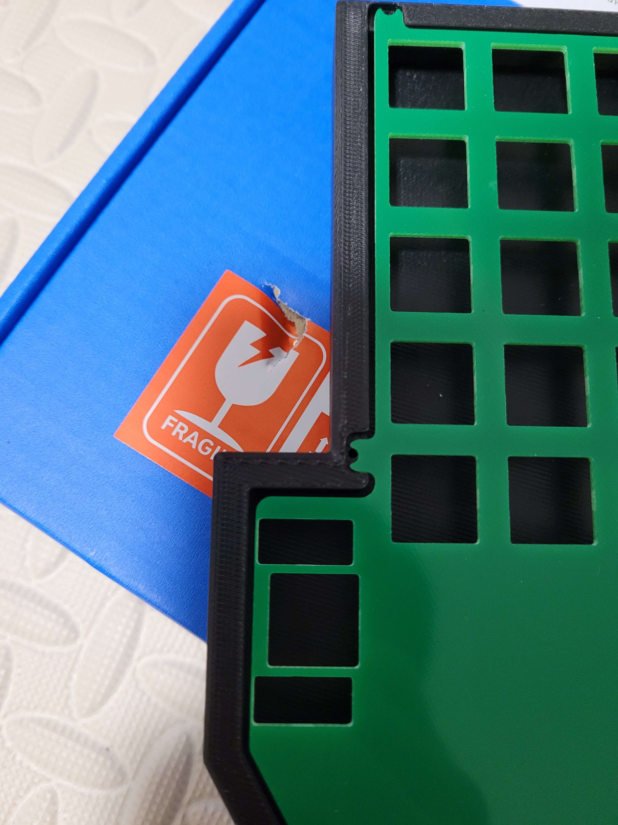
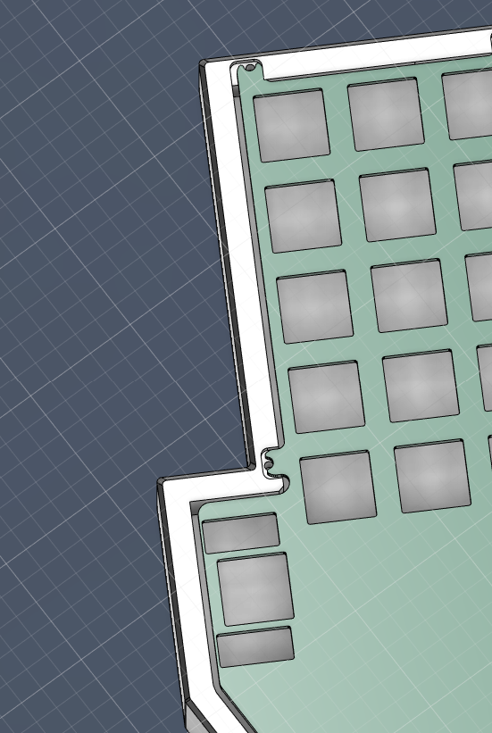
Case Manufacturing (cont.)

Slide 9
PCB Design
Original Plans
Create an integrated pcb (simple as that)
Demo 1 Timeline
As presented in the demo, I had finished up the pcb with rp2040/kb2040 devboard.
As I wait on production, I am working on a whole new revision that is an integrated pcb

Slide 10
PCB Design (cont.)
After Demo 1 Timeline
My original plan was to go and order the pcb I had by Demo 1 as the safety/working exercise pcb.
…I couldn’t send it in for production. It was too messy
I decided to just start working on the integrated pcb and have that ordered within a few weeks.
It turned out to be too hard of a task. I was reading documentation on all of the extra parts needed that was already included in the development board.
I was working on learning up on crystals/oscillators that were necessary due to the usb’s strict protocols on timing, but realized I was running out of time.

Slide 11
PCB Design (cont.)
After Demo 1 Timeline
I decided that with the new stuff that I learned along the way, I needed to get the kb2040 pcb redone and out for production.
This still took around 2 weeks as I was still having troubles with routing and trying to troubleshoot the errors showing up in the drc
Eventually with trial and error of redefining the pins on the dev board I was able to get it to a place where I could send it in for production

Slide 12
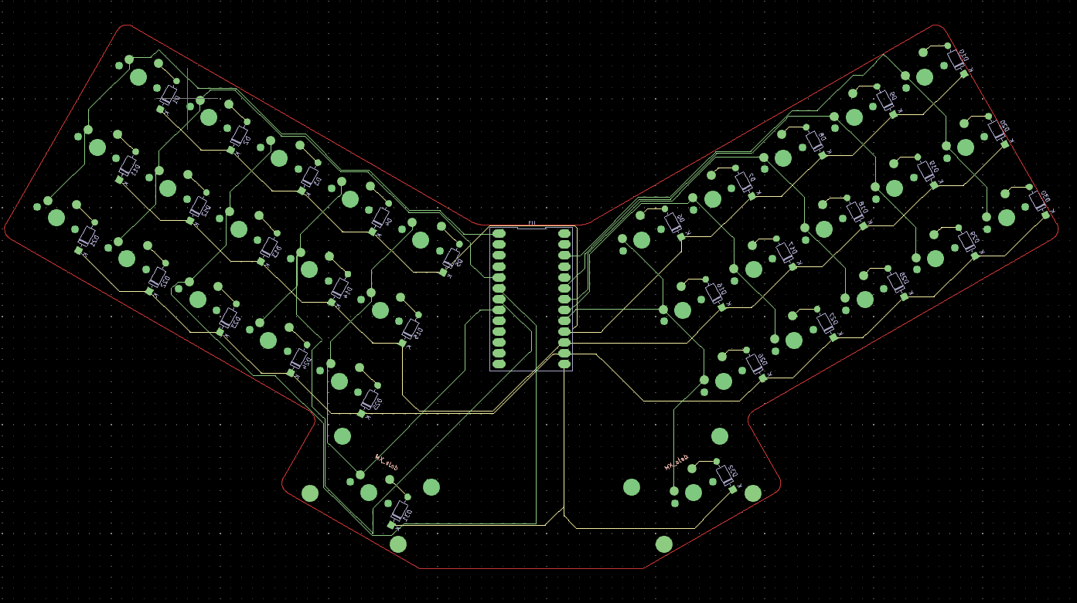
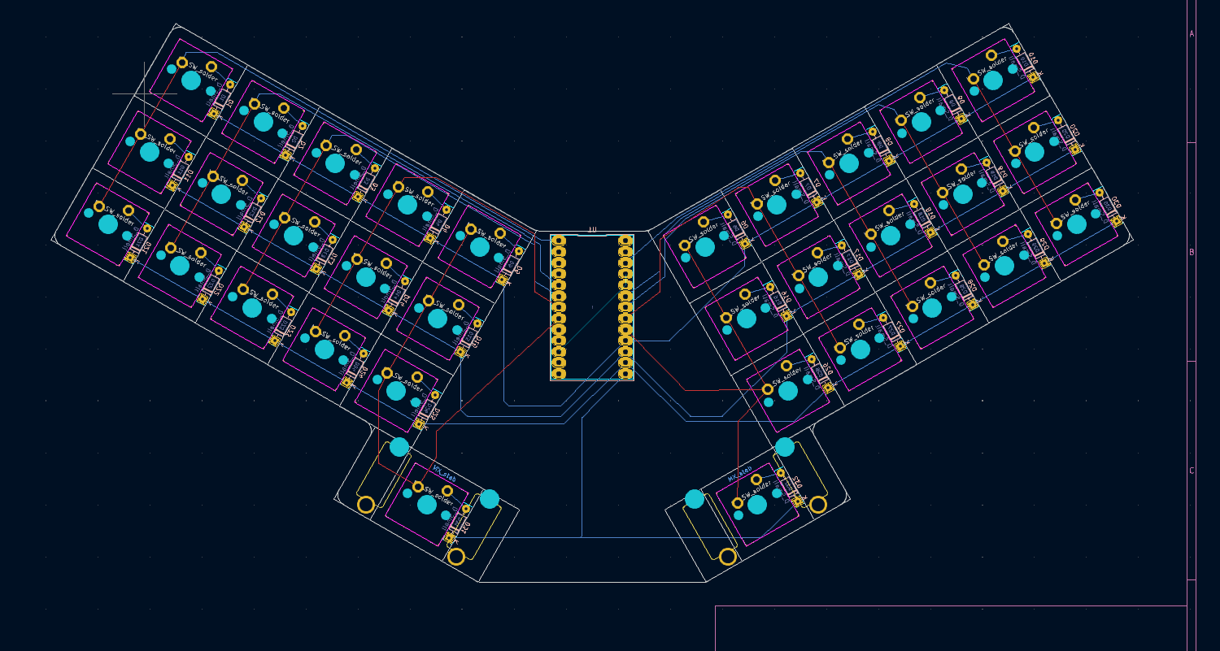
PCB Design (cont.)
VS
Original pcb that I nearly submitted before I cancelled the quote
Final pcb design that was sent for manufacturing

Slide 13
PCB Manufacturing
Demo 1 Timeline
Currently I have the devkit version of the pcb going through a manual quote because the autoquoter was having issues. I hope to hear back from them in a few days.
While that pcb is being quoted and sent for production, I will be continuing on working on the integrated pcb, making the devkit pcb a backup in case something goes wrong or I don’t have enough time.
Side note for the case, I saw that jlc has 3d printing and material milling services as well, so if all goes well and the price is reasonable I might check out their options.
Milled polycarbonate or abs seems like a very interesting option

Slide 14
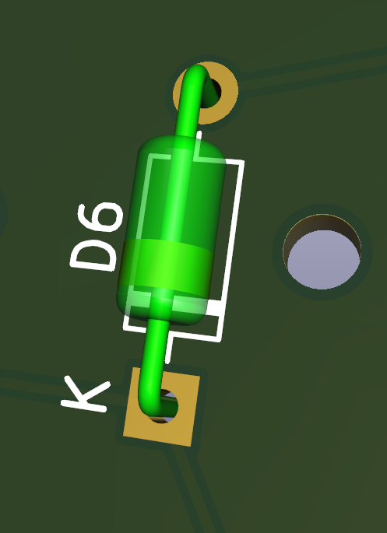
PCB Manufacturing (cont.)
After Demo 1 Timeline
The ordering process came with its own hiccups.
Many of the scripts that were used to create a BOM and the centroid files for jlc were not working and it took a bit of work to troubleshoot the errors
Those files were eventually created and sent for quoting, and in a few days I received a notice from jlc that there was an issue with my order in which I had chosen parts (surface mount diode) that did not work with the footprint that I had placed on my pcb (through holes for tht diodes)...

Slide 15
PCB Manufacturing (cont.)
After Demo 1 Timeline
After some back and forth emails, I had decided that it would be easier to order and solder the diodes myself, rather than replace the footprints due to the rotation/positioning of my footprints
They cancelled the assembly and proceeded with the order (which also had the plate in it)
After receiving the parts in hand, everything looked great, which was a relief since their integrated gerber viewer was showing some wonky things

Slide 16
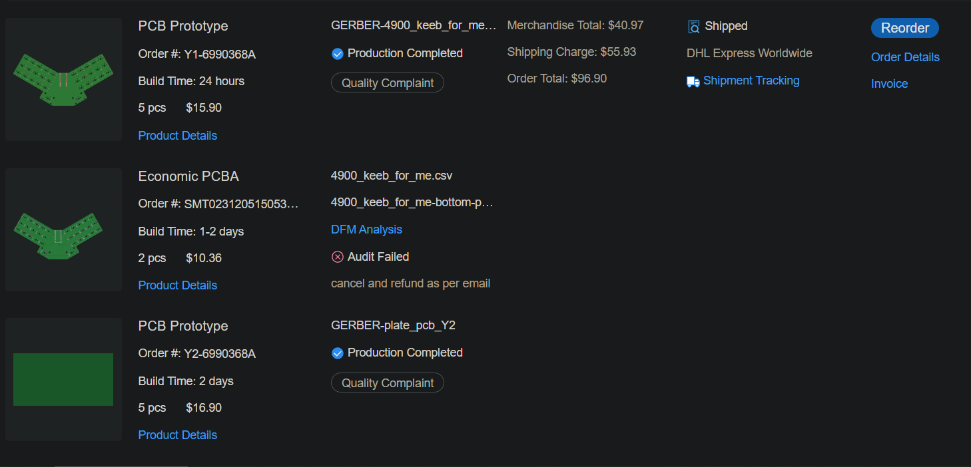
PCB Manufacturing (cont.)
The gerber straight up just shows a green rectangle

Slide 17
Plate Design
Original Plans
Create plates based off of pcb and case designs
Create them while waiting for pcb manufacturing and case prototyping
Demo 1 Timeline
Not much has changed
Design follows the case design, so once the mounting worries are sorted out, should be easy enough to create a plate

Slide 18
Plate Design (cont.)
After Demo 1 Timeline
The plate design portion was rather simple, and just took a few hours of playing around with the pcb kicad files and some lines/filleting
I was able to use the dimensions of the plate to base my case dimensions off of as mentioned before

Slide 19
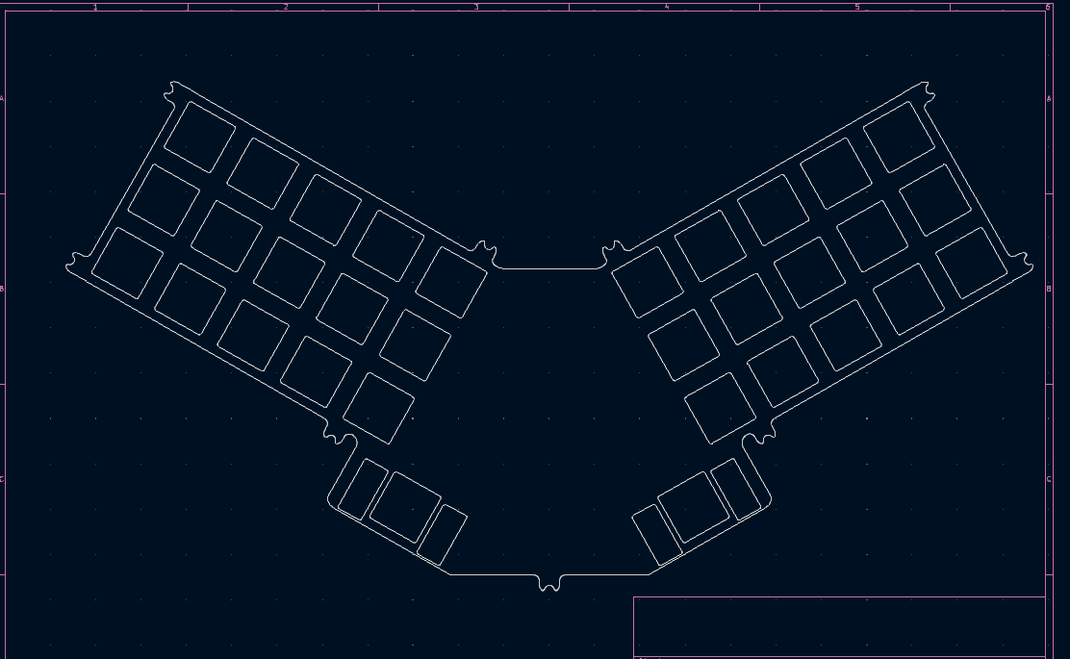
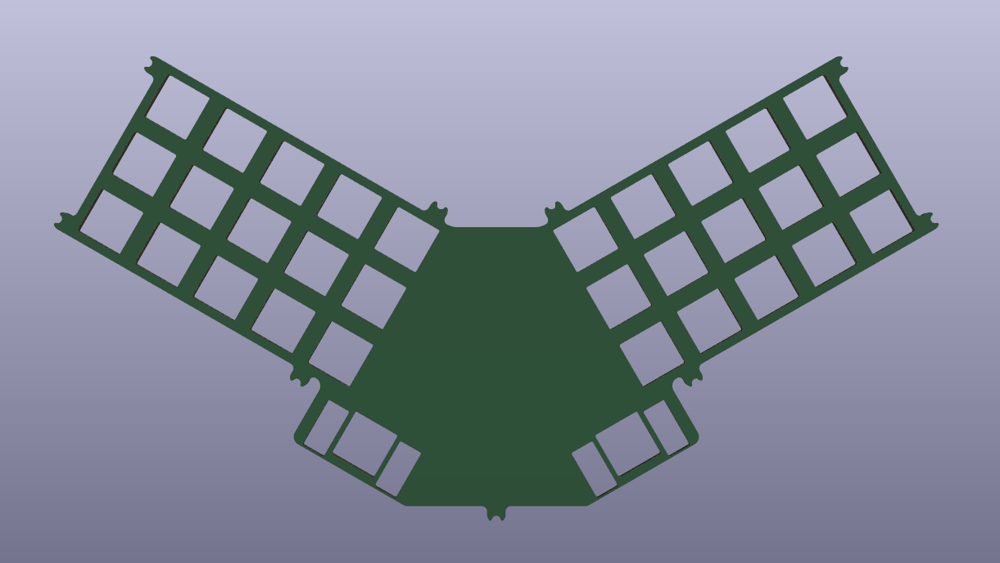
Plate Design (cont.)

Slide 20
Plate Manufacturing
Demo 1 Timeline
Waiting on final case design
Still the same plans as talked about in the demo

Slide 21
Plate Manufacturing (cont.)
After Demo 1 Timeline
Sent in files for manufacturing along with pcb
Nothing went wrong in this department

Slide 22
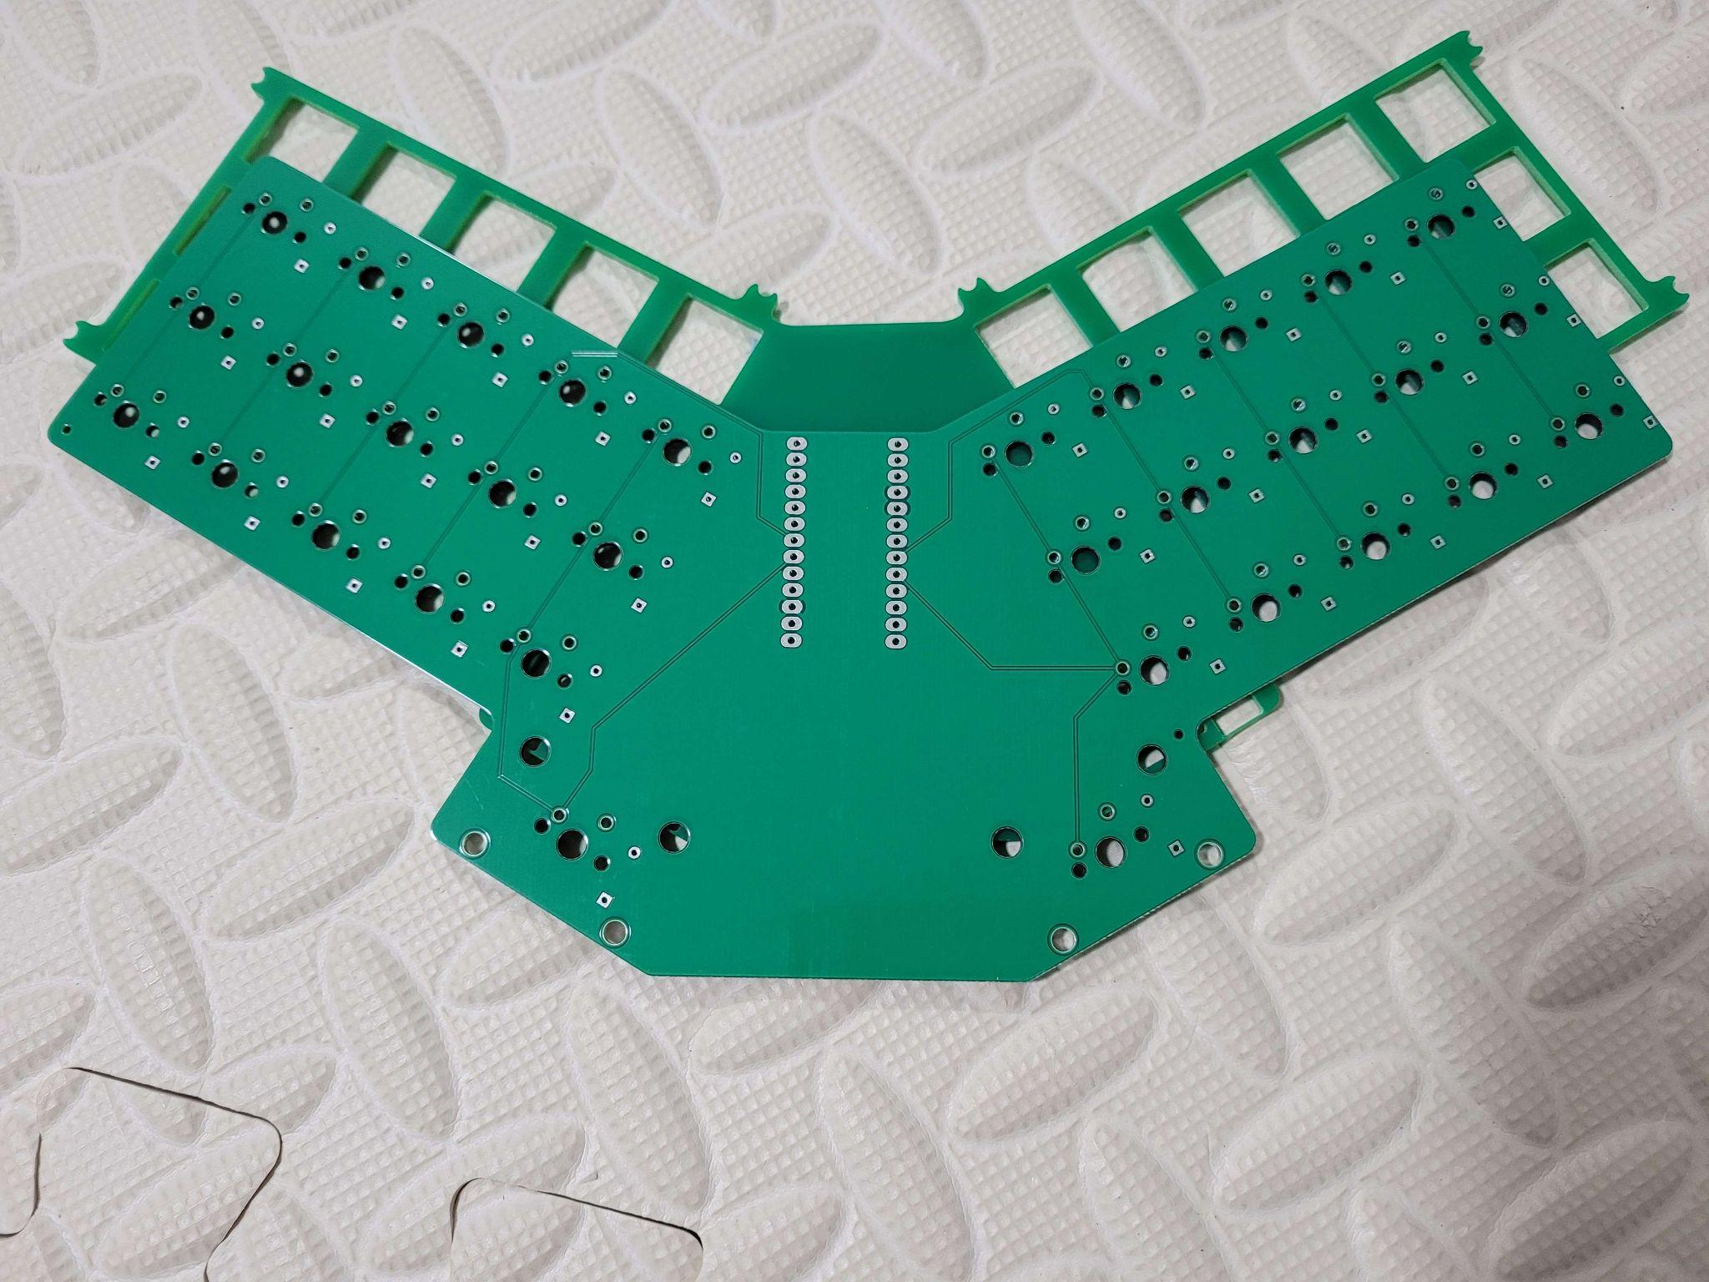
Plate Manufacturing (cont.)

Slide 23
Layout Creation
Demo 1 Timeline
Layout has been finalized
Layers have been organized in google sheets so that it won’t be a headache when creating a firmware for it

Slide 24
Firmware creation
Demo 1 Timeline
Have not started working on firmware

Slide 25
Firmware creation (cont.)
After Demo 1 Timeline
Firmware creation was pretty straightforward
Reading the QMK documentation and looking at examples of other qmk keyboard firmwares made it pretty clear what I needed/wanted
After I implemented my layout I had some errors in compiling my firmware with qmk msys and chalked it up to some mistakes and decided to chip at it over time.
After some time I realized that nothing I was trying was working, and after some research and asking around I realized that in order to create your own keyboard/firmware and get it compiled in qmk you need to submit a pull request towards the main branch and get it accepted

Slide 26
Firmware creation (cont.)
After Demo 1 Timeline
This was an issue as I thought that the firmware side of things was pretty much nearly done
I did more digging and found 2 possible solutions.
Compile the firmware with the pico-sdk rather than qmk
Try out a hack where you use an already accepted keyboard’s files and insert your own and try to compile it
At this point I didn’t have enough time to learn building firmware that wasn’t from QMK, and my jlc orders were still not in hand
I decided to go through the list of keyboards in the list until I found a keyboard that was similar to mine and decided insert my files and compile my firmware as if it was that keyboard
I chose the reviung39 because it looked similar to my board, but it turned out that they were created very differently.
There was quite a bit of troubleshooting that took a few weeks, but I eventually was able to compile my firmware and got the uf2 file that I needed to flash my rp2040/kb2040

Slide 27
Assembly
This was when I started testing my board since I had put the firmware into the kb2040 already in advance.
It was not pretty. The keytester was showing up random keys and mostly no keypresses.
After some troubleshooting I decided to just solder in the switches and try to get a complete look of the build.
The screws threaded themselves well and at least the physical build was complete. Although I am looking to sand the usb port down a few mm
I took out the pcb from the case and have been troubleshooting since.
I was able to get to this point where many of the keys are still not registering correctly.
I am trying to work until the very end, but cannot determine where the issues lie. I’m wondering if it’s a combination of both issues in the firmware and hardware/assembly.

Slide 28
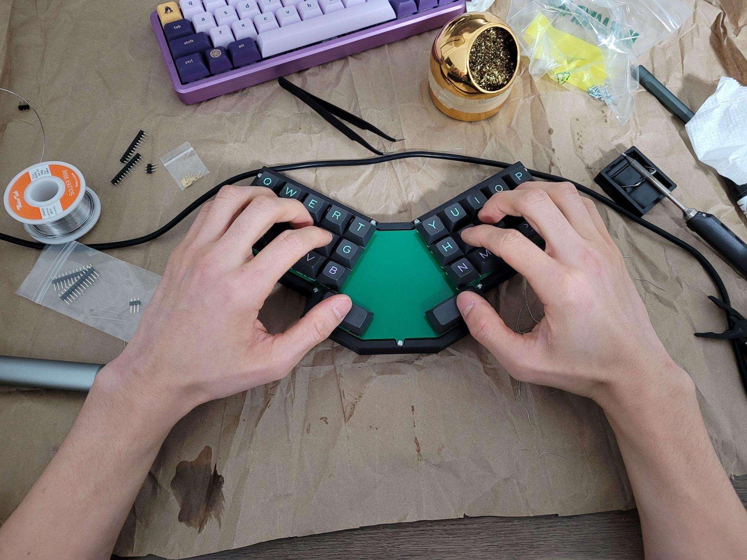
Assembly

Slide 29
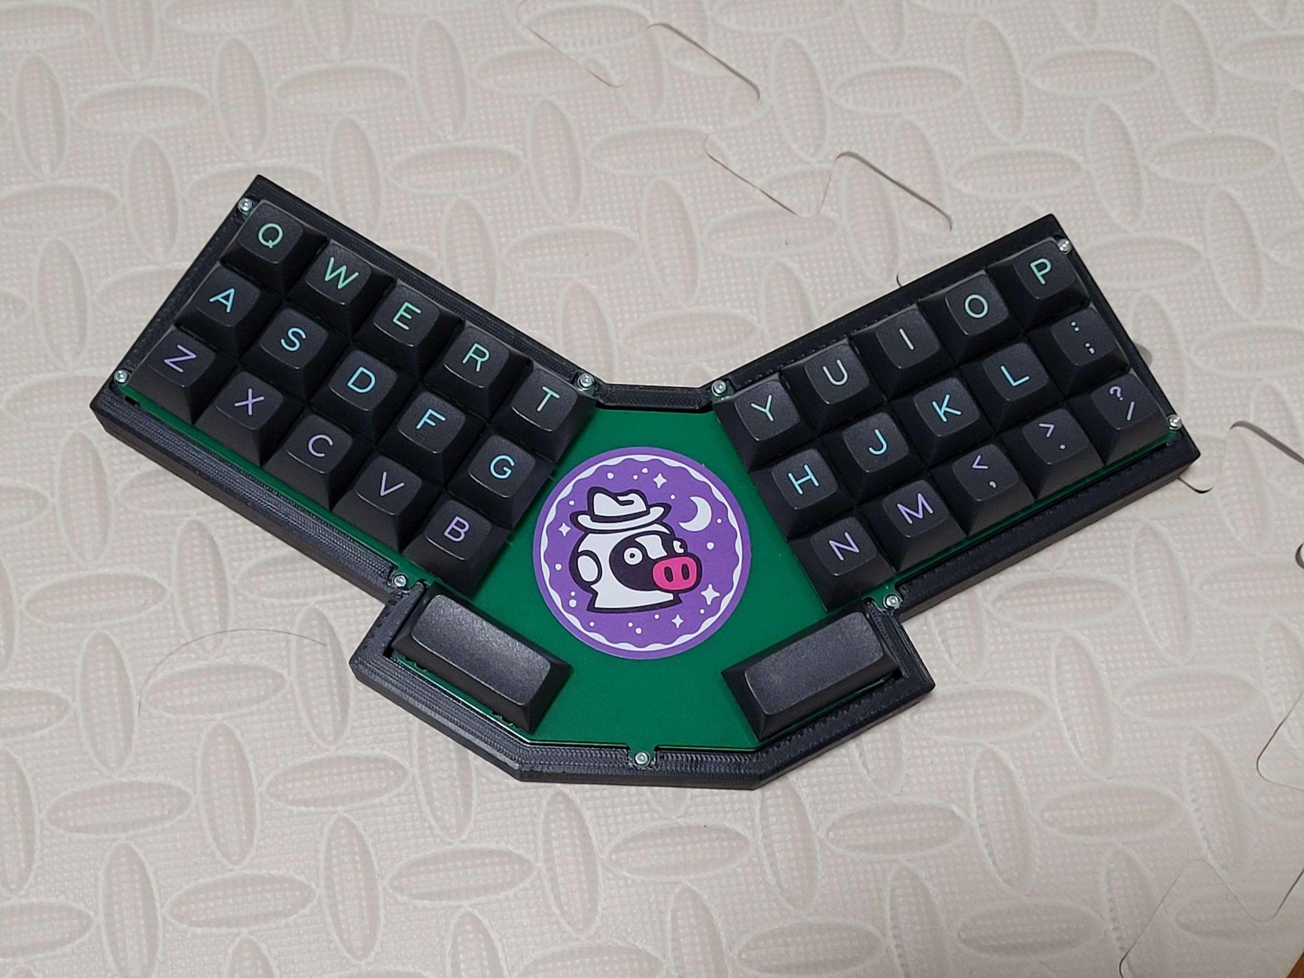

Slide 30
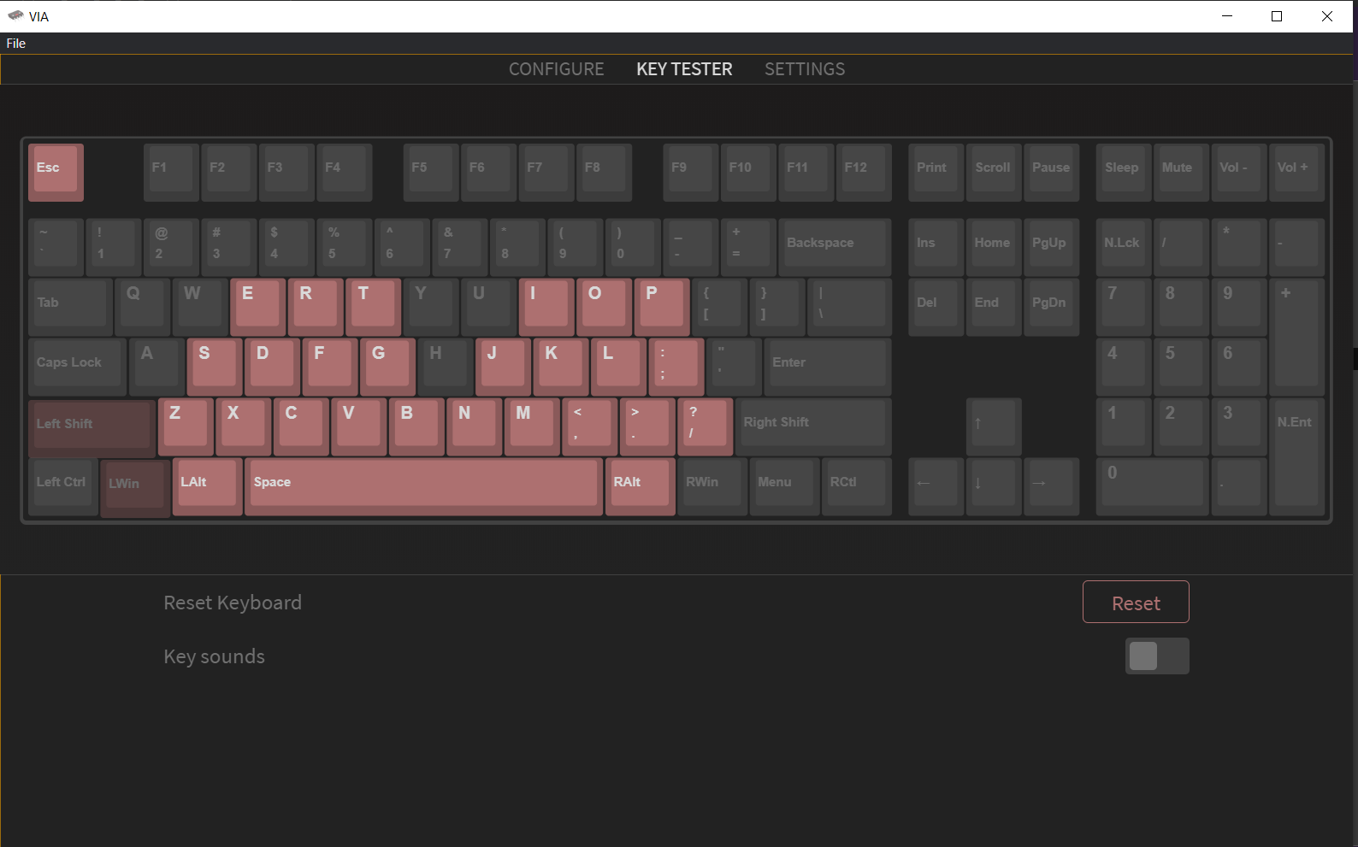

Slide 31
Final Thoughts
In the end I do not have a fully functional working product
I feel like I’m very close and will continue working this out until I have a fully functional build,
This project was a great experience in all of the issues that could arise when I create my next design.
I think finishing this out will give me even better insight that I can carry along with me.
Although this was very stressful (lol) I am very happy to have dove into the deep end to get me rolling on electrical components and 3d modeling.
I retrospect, I think treating this project as both a learning/getting experience, as well as trying to fulfill a goal of satisfying my ergonomic needs was way too much.
I believe starting out with a smaller perhaps 4-key test board, finalizing it, then moving onto a slightly more complicated, but still normal board would have really made things fall better into schedule.

